Slide 2
Part 2: RAD + Other Repositioning Options

Slide 3
Why Reposition
Intro to Repositioning Options
How do I choose?
Case Studies
Q&A

Slide 4
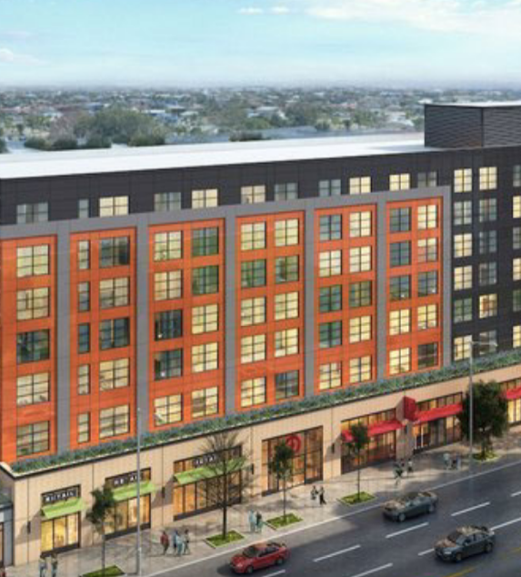
Why Recapitalize?
Address backlog of capital needs to create better living conditions for residents
Access debt and equity to finance improvements
Preserve affordable housing for the long term
Simplify program administration
Protect resident rights

Slide 5
Repositioning Options

Slide 6
Public Housing Repositioning Options
Public Housing Property
Conversion Tool
Section 18
Demo/Dispo
Streamlined
Voluntary Conversion*
RAD
Outcome
PBRA
Section 8 Project-Based
Rental Assistance
PBV
Section 8 Project-Based Voucher
Section 8 Tenant-Based Voucher
* Under Voluntary Conversion tenant protection vouchers must first be offered to residents as tenant-based assistance but may be project-based with tenant consent.

Slide 7
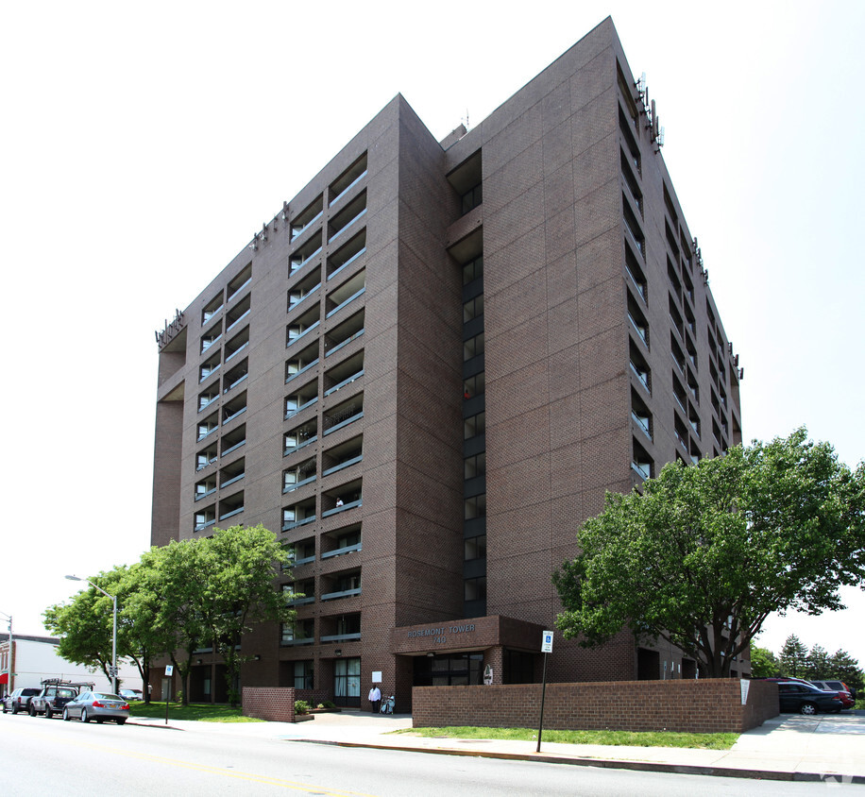
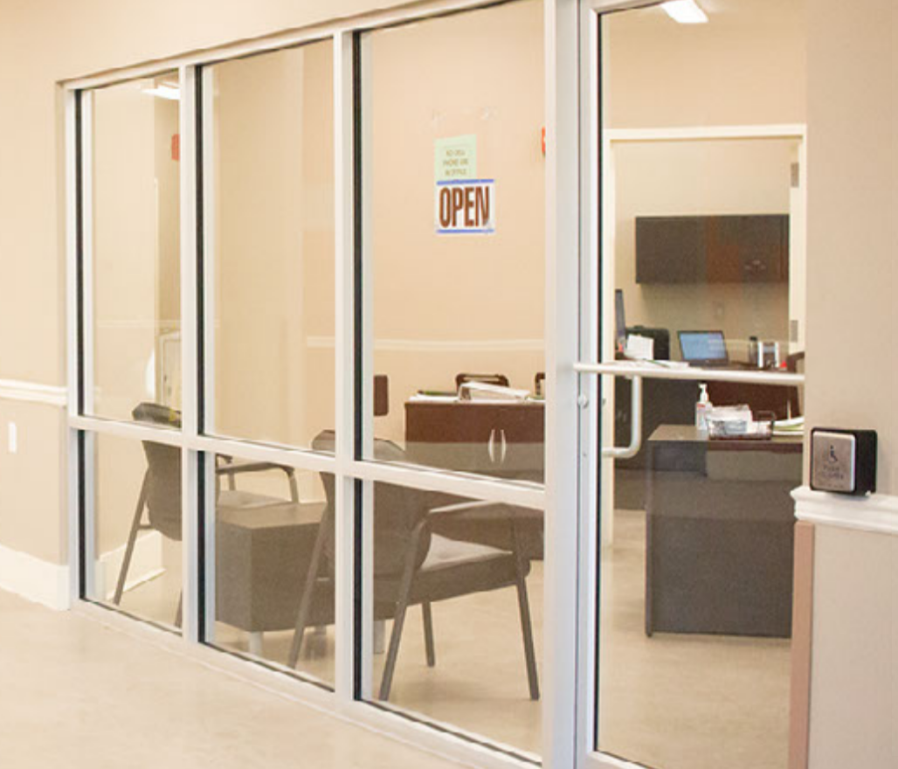
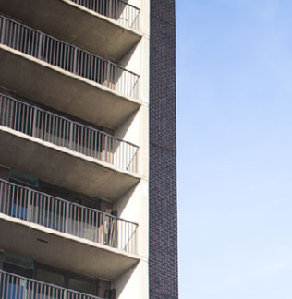
What is RAD?
RAD allows PHAs to convert their Section 9 ACC to a Section 8 Project-based Voucher (PBV) or Project-based Rental Assistance (PBRA) contract. This is a powerful tool to preserve and improve public housing properties.
RAD helped redevelop 144 apartments at the Lakeview Towers Extension in Baltimore, MD.

Slide 8
RAD Key Features
Stable Funding
Predictable initial contract rents based on public housing funding – “2020 RAD Rents” based on FY 2020 levels
Rents adjusted by Operating Cost Adjustment Factor (OCAF)
Recapitalization
Capital Needs Assessment completed to determine rehab needs
Tenant Rights
Resident right of return + prohibition against rescreening
“Choice-mobility” requirement
Public Stewardship
Ownership or control by a public or non-profit
Long-term HAP contract must renew at each expiration; RAD Use Agreement recorded on land
Public housing organizing and procedural rights continue
PHA must secure financing and fund Replacement Reserve to address needs
One-for-one hard unit replacement (with de minimis exception)

Slide 9
Section 18 Disposition and Demolition
“Section 18” refers to the authority under which PHAs can demolish or dispose of (sell) public housing property
A property must meet Section 18 criteria to be eligible (not all properties qualify)
Following a Section 18 approval from HUD, the PHA is eligible for new “Tenant Protection Vouchers” (TPVs) to replace the affordable housing assistance
The Tenant Protection Voucher assistance can be tenant-based or project-based (i.e. Project-based Voucher) at full Fair Market Rent levels
HOTMA (2016) made it easier for PHAs to project-base vouchers on former public housing properties
See PIH Notice 2021-07

Slide 10
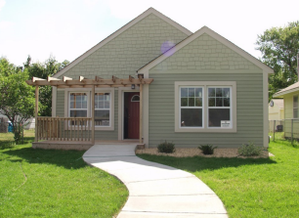
Section 18 Disposition and Demolition
Options
Preserve or redevelop asset as affordable housing
Project-Based Vouchers (PBVs) (HOTMA exceptions)
Rehab with other financing (LIHTC)
“Commensurate Public Benefit”
Sell asset on the open market at fair market value
Asset is physically obsolete (“as is” sale) or current location is undesirable/isolated
Give residents tenant-based vouchers
Generate proceeds - facilitate off-site development of PBV or PH
The PHA in and for the City of Minneapolis used Section 18 for the disposition of 717 scattered site units. These homes are now kept affordable under the project-based voucher platform.

Slide 11
Section 18 Justifications
Most Common
Physical obsolescence
Scattered-site
PHAs with 50 public housing units or less
RAD & Section 18 Blends
Less Common
Surrounding Area
Health and safety
Infeasible operation
Non-dwelling property
“More efficient/effective”
De Minimis (Demolition only)

Slide 12
Section 18: Physical Obsolescence
Eligibility
CNA shows that immediate repair and replacement needs of the property exceed the obsolescence standard - 57.14% of TDC for non-elevator building, 62.5% for elevator building
Costs include environmental, lead remediation or bringing property to fire code
Typical Future Use
Sell the property in the open market
Redevelop the property with Project-Based Vouchers

Slide 13
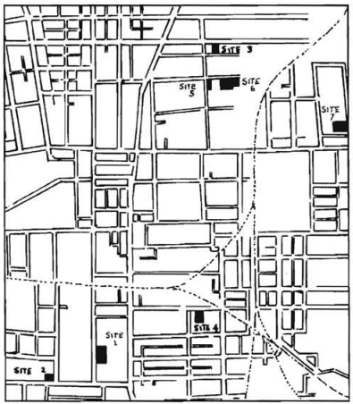
Section 18: Scattered Site Units
Eligibility
Buildings are non-contiguous with 4 or fewer units
Unsustainable to operate and/or maintain
Typical Future Use
Sell the property in the open market
Place properties under Project-Based Voucher contract
Create local homeownership program
Some and some

Slide 14
Section 18: Very Small PHA
Eligibility
PHA has 50 or fewer public housing units
Must close-out Public Housing program via Consolidation/Transfer or ACC Termination
Typical Future Use
Sell the property in the open market
Place properties under Project-Based Voucher contract
Other considerations: If Public Housing-Only PHA, must find Voucher PHA to administer vouchers

Slide 15
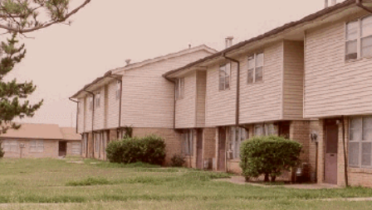
RAD & Section 18 Blends
PHAs can use RAD and Section 18 together. Notice PIH 2021-07 describes RAD/Section 18 Blends, which bring the best of both tools:
Higher contract rents support greater financing
Robust resident rights
RAD one-for-one replacement reqs apply (w/ de minimis)
Public housing funds can be used in project conversion
HUD underwriting of entire project to ensure project viability
The Oklahoma City Housing Authority used a RAD/Section 18 Blend to undertake substantial renovations at Sooner Haven Apartments.
79 RAD/Section 18 blends since Oct. 2019 – average construction/rehab cost of $155k per unit

Slide 16
Two Types of Blends
Construction Blends – Based on proposed construction costs for new construction or rehabilitation relative to HUD-published “Hard Construction Cost” thresholds
Small PHA Blends – For PHAs with 250 or fewer public housing units
Up to 80% of the units may be disposed of under Section 18, but PHA must have a plan to recapitalize and convert all of its public housing units
Required HCC Threshold | RAD / Section 18 Blend Percentage
>30% | 80% RAD / 20% Section 18
>60% | 60% RAD / 40% Section 18
>90% | 40% RAD / 60% Section 18
>90% + in high-cost area (Local HCC > 120% of national average HCC) | 20% RAD / 80% Section 18

Slide 17
Construction Blends
Example:
100 unit elderly building in East Baton Rouge
RAD Rents are approximately 86% of FMR
Construction Costs per Unit | RAD/Section 18 Construction Blend | Average Contract Rents (Estimate)*
<$31k (less than 30% of HCC) | 100% RAD | $650
Between $31k and $62k (between 30-60% of HCC) | 80% RAD / 20% Section 18 | $692
Between $62k and $92k (between 60-90% of HCC) | 60% RAD/40% Section 18 | $730
More than $92k or new construction (more than 90% of HCC) | 40% RAD/ 60% Section 18 | $776
*Assumes RAD rents set at $650 and PBV rents set at 110% of FMR
Notes:
Note to Will – I used the figures you showed me, inflated to the 2022 OCAF and used 110% of the 2022 FMR for East Baton Rouge.

Slide 18
Sample Pro Forma
Example:
100-unit East Baton Rouge property
Debt Scenario under RAD
At today’s FHA mortgage terms, the property could support $2.4 million ($24k per unit) in debt
Pro Forma | Per Unit | Project
Potential Rents | $650 | $780,000
Vacancy Loss | ($20) | ($23,400)
Bad Debt Loss | ($13) | ($15,600)
Other Income | $13 | $15,600
Effective Gross Income | $631 | $756,600
Operating Expenses | ($451) | ($541,200)
Replacement Reserve Deposits | ($50) | ($60,000)
Net Operating Income | $130 | $155,400
Debt Scenario with a RAD/Section 18 Blend
If the property completes over $31k per unit in rehab it is eligible for a RAD/Section 18 blend
At increased revenue under the blend, it could support $3.2 million ($32k per unit) in debt

Slide 19
Small PHA Blend
Example:
PHA has 200 units across 4 properties
Repositioning Plan
Sequence | Property | Tool
1 | 40 Scattered Site Units | Section 18 – Scattered Sites | Sells 20 and generates proceeds Retains 20 under an instrumentality and places under PBV
2 | 80 unit elderly high-rise – good condition | RAD/Section 18 blend (80% Section 18/20% RAD) | Places the property under PBV HAP contracts and increases revenue and services for residents
3 | 40 unit family site – needs work | RAD/Section 18 blend (80% Section 18/20% RAD) | Place the property under PBV HAP contracts and secure financing to complete rehab
4 | 40 unit barracks-style – functionally obsolete | Section 18 – Very Small PHA | Demolish the property and redevelop with PBV
Notes:
Note to Will – I used the figures you showed me, inflated to the 2022 OCAF and used 110% of the 2022 FMR for East Baton Rouge.

Slide 20
Streamlined Voluntary Conversion
Streamlined Voluntary Conversion (SVC) allows small PHAs to convert their inventory to tenant-based vouchers and closeout their Public Housing Program (Section 9 ACC).
Must be a small PHA (250 or fewer Section 9 public housing units under ACC) and convert all remaining units by transfer, consolidation, or ACC termination. Then, close out public housing program. See PIH Notices 2014-24 and 2016-23.
Cannot project-base the vouchers without tenant consent

Slide 21
How do I choose?

Slide 22
Strategic Choice: Preserve or Dispose
Some sites are poor locations for affordable housing, are too expensive to maintain, or are in markets with excess supply of housing
Dispose and provide residents with tenant-based vouchers (Section 18 or Streamlined Voluntary Conversion)
Or, if does not qualify for Section 18 or Streamlined Voluntary Conversion → RAD Transfer of Assistance
Original property can be sold and proceeds can be used to support RAD rehabilitation or redevelopment
Homeownership also an option in lieu of preservation as affordable rental
Preserve
Preserve or dispose the asset?
Dispose
Sec 18 or SVC

Slide 23
Strategic Choice: Compare RAD to PBV Rents
Compare the RAD Rents vs. the regular PBV rents (lesser of 110% of FMR, less utility allowance, or reasonable rent)
If RAD rents equal or higher (~40% of all public housing), stick with RAD (unless wish to voucher out)
If RAD rents lower, consider Section 18 where eligible
Data Sources
RAD Rents: hud.gov/rad
FMRs: HUDUser.gov
Reasonable Rent: PHA
RAD Rent | PBV Rent
$600 | 110% of FMR = $800 - UA = $100 110% of FMR, Less UA = $700 Reasonable Rent = $900 PBV Rent = $700
RAD Rents lower
Compare RAD Rents to
PBV Rents
RAD rents higher
RAD

Slide 24
Strategic Choice: Section 18 Eligibility
Scattered site (non-contiguous) with operational challenges can qualify under Section 18 without demonstrating “obsolescence”
PHAs with 50 or fewer units (including last 50 units of a larger portfolio) can qualify under Section 18 without demonstrating obsolescence
Note: HUD has also created a streamlined RAD conversion for PHAs with 50 or fewer units
If property is eligible for Section 18 or SVC, Section 18 provides more flexibility to the PHA
PHA’s choice to PBV or give tenants vouchers
No
Eligible for Sec 18 based on PHA size, scattered site?
Yes
Sec 18

Slide 25
Strategic Choice: Assess Capital Needs
RAD
RAD & Section 18 Blend
Section 18 (Obsolete) or
Choice Neighborhoods
HUD Program
Extent of Capital Needs
Preservation Strategy
No debt “Straight conversion”
Rehab with debt and/or 4% LIHTC
Substantial Rehab or Demolition/New Construction with 4% LIHTC or 9% LIHTC

Slide 26
RAD vs. Section 18 Considerations
WHY CHOOSE SECTION 18 | WHY CHOOSE RAD | WHY CHOOSE SVC
Contract rents available through standard Project-based vouchers is often better than the RAD rent | Sometimes RAD rents are equal or better than voucher rents | Contract rents available through standard Project-based vouchers is often better than the RAD rent
Tenant consent to project-base not required but disposition required | Neither tenant consent to project-base or disposition required | Disposition not required but tenant consent to project-base required
No requirement to preserve all units | Preserve all units, with de minimis exceptions | No requirement to preserve all units
Eligible for DDTF/ARF (if there are eligible expenses) | Not eligible for DDTF/ARF but receive Rehab Assistance Payments | Not eligible for ARF/DDTF or Rehab Assistance Payments
 | Other: Can convert both to PBV and PBRA No rescreening of residents Use of public housing funds More easily can “transfer assistance”

Slide 27
www.hud.gov/rad
Email questions to
rad@hud.gov

Slide 28
Appendices

Slide 29
Strategic Planning – Property Considerations
What do you want to do with the property?
How many total units do you have?
Which option produces the highest rents?
Have the majority of units been occupied by an assisted family within the past 24 months?
Is the current site well situated to continue providing assistance?
What level of capital needs does the property have?
Do you want to close out the entire public housing program?

Slide 30
Assessing the Project Financials
Revenue
Operating Expenses
Capital Needs

Slide 31
Revenues and Proceeds
Revenue
RAD Rents are initially locked-in based on public housing funding levels and then inflated by OCAF each year
PBV Rents are established at the “reasonable rent” up to 110% of FMR minus the Utility Allowance inflated at agreement of PHA and Owner with cap of 110% of FMR minus the Utility Allowance. PBV rents are re-assessed each year
Impacted by vacancies and bad debt (uncollected tenant rent)
Proceeds
Annual Cash Flow
Developer Fees
Disposition Proceeds

Slide 32
Project Revenue in a RAD Conversion

Slide 33
Operating Expenses
Maintenance, utilities, admin, services, etc
Opportunity to reduce utility bills through energy/water efficient improvements
Continue or re-negotiate Payment in Lieu of Taxes (PILOT) or property tax exemption
Plan and prorate maintenance and staff needs
Prepare Operating Pro Forma that shows projected changes in operating expenses initially (i.e., compared to public housing) and for term of initial PBV or PBRA contract
Replacement Reserve set based on capital needs

Slide 34
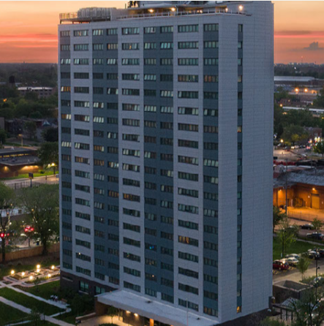
Capital Needs
Capital Needs Assessment identifies the immediate and
Replacement Reserves
Initial Deposits
Annual Deposits
The Chicago Housing Authority renovated 181 senior apartments at Fannie Emanuel using RAD.

Slide 35
RAD vs. Section 18 Considerations
 | WHY CHOOSE SECTION 18 | WHY CHOOSE RAD | WHY CHOOSE SVC
Rent levels | Often higher than the RAD rent | Sometimes RAD rents are higher | Often higher than the RAD rent
Tenant Consent to Project-Base | Not required | Not required | Required
1 for 1 Hard Replacement Requirement | None | Yes, with de minimis exceptions | None
Require to Dispose of the Asset | Yes | No | No
Eligibility for DDTF/ARF | Yes | No | No
Rehab Assistance Payments | N/A | Yes | N/A
Use of Public Housing Funds | No | Yes | No
Conversion Type | PBV | PBV or PBRA | PBV or none
Rescreening | Yes | No | Yes
Minimum Voucher Program Size | None | Streamlined RAD = 100 Streamlined RAD = 250 | None
PHA Closeout | Only for 50 or Fewer | Only for Streamlined RAD | Yes

Slide 36
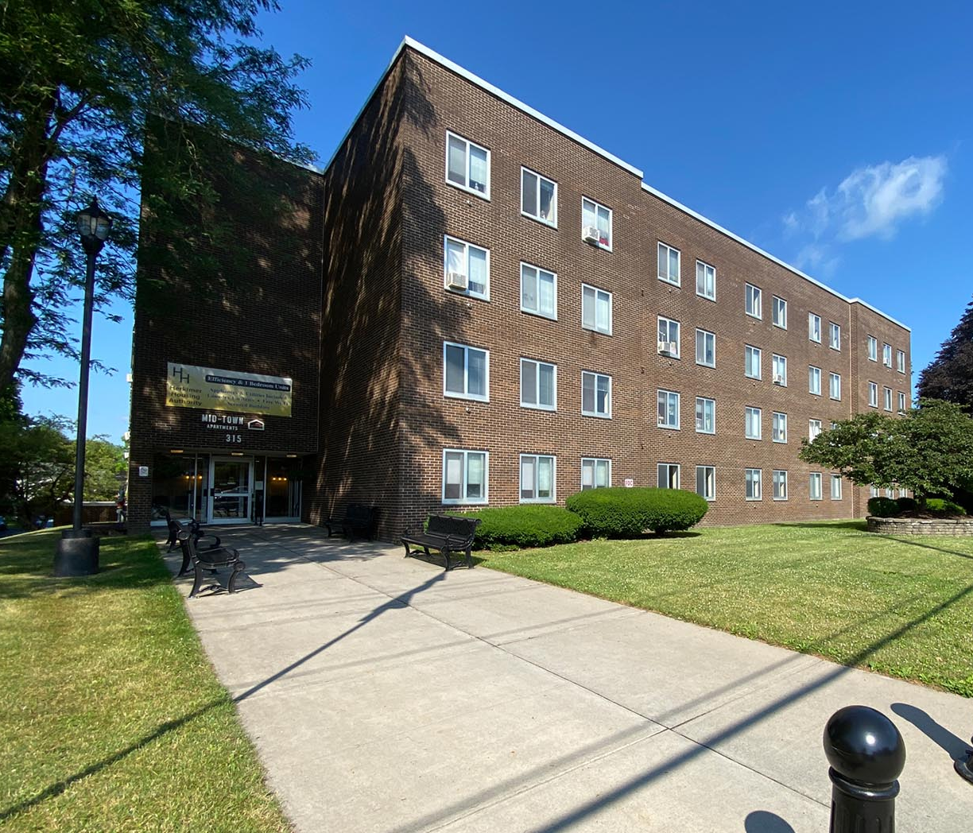
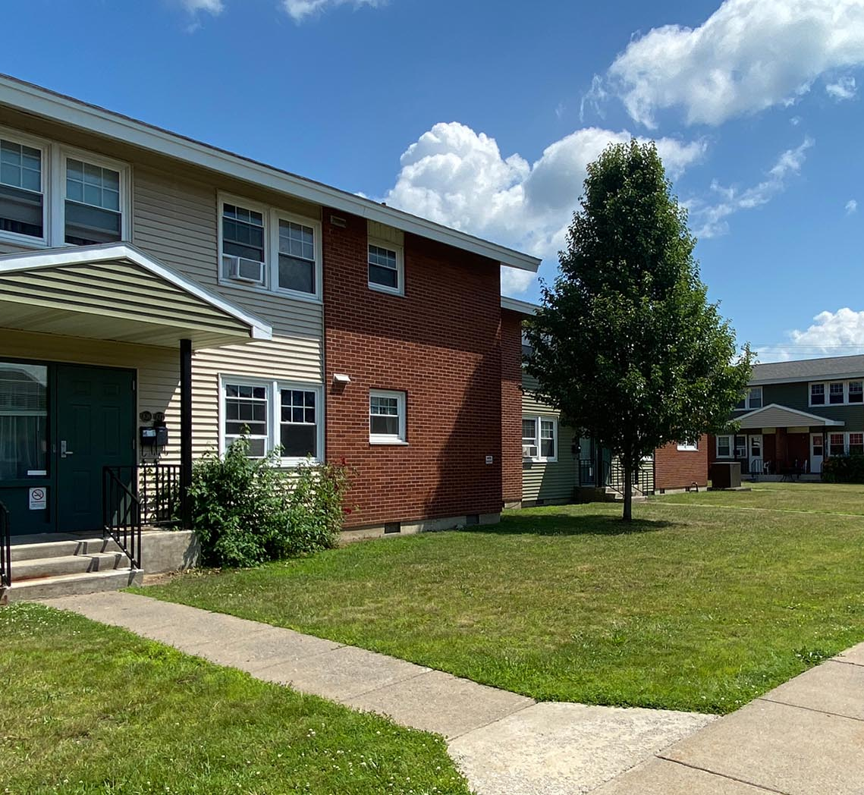
Herkimer Housing Authority (aka Stone Ridge Residences)
Today
125 units of 1970s era public housing + vacant land
The Tools
RAD/Section 18 Small PHA Blend
Equity (4%), State funds, debt
The Future
Rehab and reconfiguration of 113 public housing units, including abatement of asbestos and lead-based paint
Acquisition/Rehab of 16 units
New Construction of 24 units

Slide 37
Key Resources
RAD Statute
RAD Implementation Notice, Revision 4: H 2019-09, PIH 2019-23
Fair Housing, Civil Rights and Relocation Notice: H 2016-17 PIH 2016-17
Guides and FAQs (www.radresource.net)
RAD Inventory Assessment Tool

